Slide 1
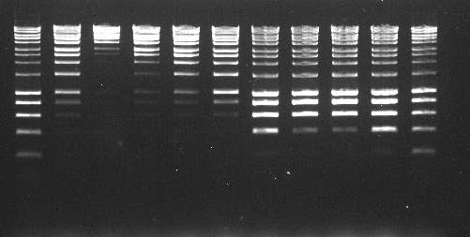

1 2 3 4 5 6 7 8 9 10 11
Insights into DNA extraction and library preparation
for Nanopore sequencing on the MinION
Benjamin Schwessinger
in collaboration with
Miriam Schalamun, Ramawatar Nagar, Robert Lanfear, John Rathjen, et al.,
DECRA Fellow, Austaralian National University
19-20/03/2018
UTS, Sydney

Slide 2
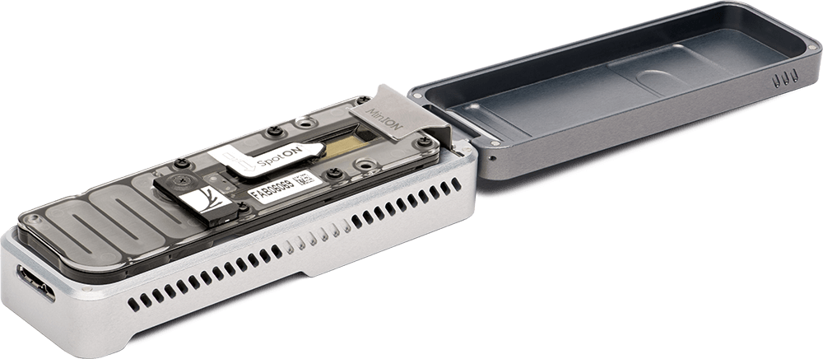
Intro into MinION sequencing
https://community.nanoporetech.com/posts/getting-started-knowledge

Slide 3
Intro into MinION sequencing
Lannoy et al., 2017 bioRxiv

Slide 4
Intro into MinION sequencing
Josh Quick, F1000, 2017

Slide 5
Intro into MinION sequencing
Basecalling within MinKNOW, or on server e.g. albacore (nanonet, scrappie, guppy)
fast5 w/ basecalls and/or fastq
https://github.com/rrwick/Basecalling-comparison
Josh Quick, F1000, 2017
Lannoy et al., 2017 bioRxiv
Ryan R. Wick et al., github

Slide 6

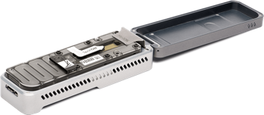
Intro library prep and DNA quality!!!
nothing out
Josh Quick, F1000, 2017
http://alison.dbsdataprojects.com/wp-content/uploads/sites/82/2016/04/garbage-in-out-image.gif

Slide 7
Intro library prep and DNA quality!!!
DNA quality!!! is king
Your concentration measured by nanodrop should be similar to Qubit max 3:1.
Can be EXTREMELY DIFFICULT AND THE MOST TIME CONSUMING STEP
Please share your protocols openly like Josh Quick, us, and others on
https://community.nanoporetech.com/posts/getting-started-knowledge

Slide 8
Intro library prep and DNA quality!!!
Josh Quick, F1000, 2017

Slide 9
Thinks to consider when extracting DNA
Be gently
Don’t vortex
Use wide pore tips (or cut them)
Avoid or get ride of small fragments
think molarity
Typical size fragmentation:
Spin column 20-100kb depending on brand
Precipitation 20-300kb
Dialysis >200kb
Agarose plug digestion
Factor influencing your DNA length:
lysis method of tissue and cells
purification method
precipitation method (e.g. ETOH vs. CTAB)
clean up (SPRI vs. propanol)
inspired by Josh Quick, F1000, 2017

Slide 10
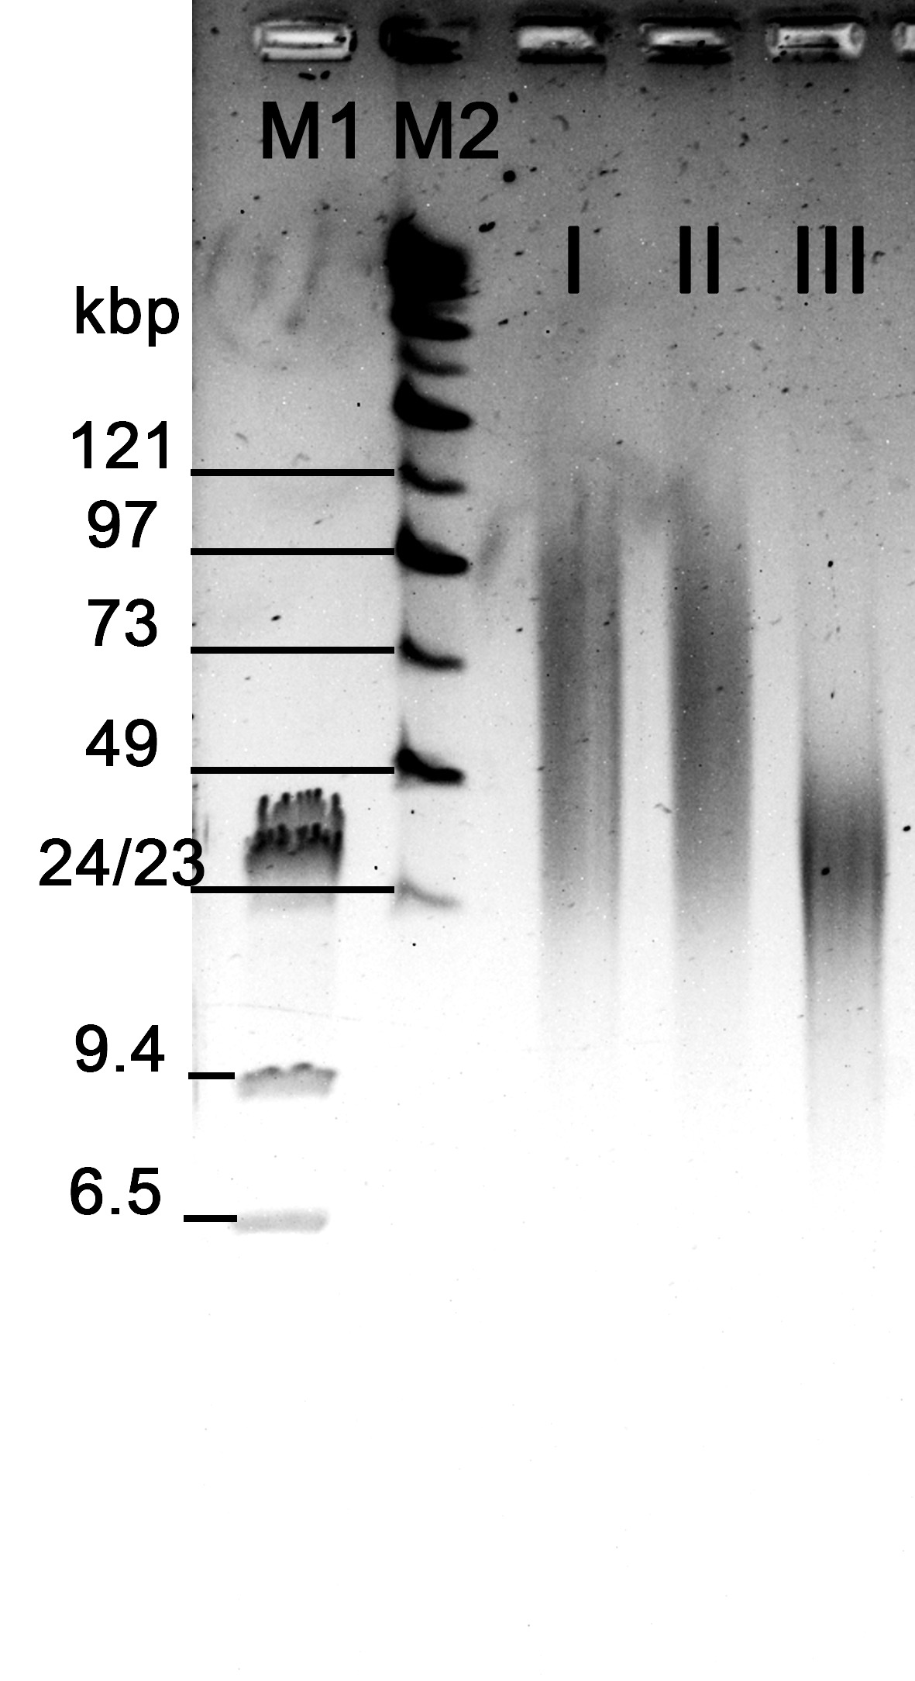
Thinks to consider when extracting DNA
Be gently
Don’t vortex
Use wide pore tips (or cut them)
Avoid or get ride of small fragments
think molarity
Factor influencing your DNA length:
lysis method of tissue and cells
purification method
precipitation method (e.g. ETOH vs. CTAB)
clean up (SPRI vs. propanol)
inspired by Josh Quick, F1000, 2017
Schwessinger and Rathjen, 2017

Slide 11
DNA quality influences sequencing output
Josh Quick, F1000, 2017

Slide 12
Library preps are about molarity not mass
Input requirement of 1000 ng is an oversimplification and advices at a suboptimal step in the protocol
What actually matters is the amount of free DNA ends (mols) into the adapter ligations
For 8kb 1000 ng ~ 0.2pmol
8kb @ 1000ng
16kb @ 1000ng
24kb @ 1000ng
http://www.promega.com/a/apps/biomath/
inspired by Josh Quick, F1000, 2017

Slide 13
Library preps are about molarity not mass
Input requirement of 1000 ng is an oversimplification and advices at a suboptimal step in the protocol
What actually matters is the amount of free DNA ends (mols) into the adapter ligations
For 8kb 1000 ng ~ 0.2pmol
8kb @ 0.2pmol
16kb @ 0.2pmol
24kb @ 0.2pmol
8kb @ 0.2pmol ~ 1000ng
16kb @ 0.2pmol ~ 2000ng
24kb @ 0.2pmol ~ 3000ng
http://www.promega.com/a/apps/biomath/
inspired by Josh Quick, F1000, 2017

Slide 14
DNA quality measurements
QC methods
your eyes
Qubit
Nanodrop
0.8% agarose (up to ~25kb)
PFGE (up to Mb)
TapeStation
What to look for
No color
c[Qubit] ~ c[nanodrop]
260:230 2.0-2.2
260:280 > 1.80
no smear downward especially < 2kb
most DNA above 25kb

Slide 15
DNA quality measured by Nanodrop
D is how it suppose to look like when c[nanodrop] ~ c[qubit]
Schalamun et al., biorxiv soon

Slide 16
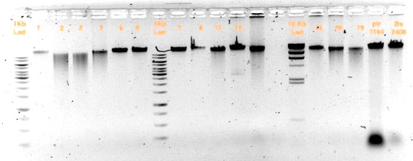
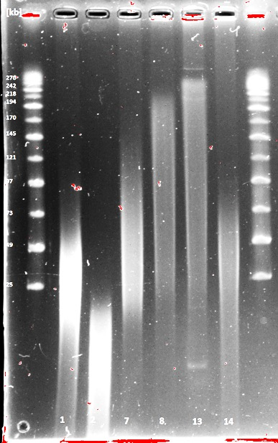
DNA integrity measured by agarose gels or TapeStations
1
2
7 8
13 14
10kb
3
1
Low quality DNA
RNA
1 2 7 8 13 14
200kb
125
Only a PFGE will show you the real size distribution of your DNA
95
73
49
24
see also Josh Quick, F1000, 2017
ANU Nanopore workshop 2017

Slide 17
Nanopore DNA sequencing decision tree for beginners
Intro library prep and DNA quality!!!
low input
HMW gDNA
> 40kb or as high as you can get
10pg+
~100ng
10-xkb
rapid kit (MuA transposase)
WGA
g-Tube
8-20kb
1-2ug
20-150kb
2-5ug
PCR
1-15 ug
g-Tube?!
1D/1D2 sequencing
Rapid sequencing
1D/1D2 sequencing
Rapid sequencing
Josh Quick, F1000, 2017
inspired by Josh Quick, F1000, 2017

Slide 18
Intro Rapid library prep!!!
https://community.nanoporetech.com/protocols/rapid-lambda-control-sqk-rad002/v/rse_9024_v2_revo_21nov2016/overview-of-the-rapid-sequ

Slide 19
Intro 1D library prep!!!
https://community.nanoporetech.com/protocols/1d-lambda-control-experime/v/cde_9001_v108_revr_18oct2016/overview-of-the-ligation-s

Slide 20
Intro 1D^2 library prep!!!
https://community.nanoporetech.com/protocols/1d%5E2-genomic-sequencing/v/lsd_9032_v11_revi_23mar2017/introduction-to-the-1d-2-s

Slide 21
A case study of setting up MinION sequencing for a difficult species
Eucalyptus
Schalamun et al., biorxiv soon

Slide 22
Getting clean and long DNA
Sample | Qubit [ng/µl] | Nanodrop [ng/µl] | 260/280 | 260/230 | Yield [Gb] | Yield_{Q7} [Gb]
10 | 178 | 203 | 1.8 | 2.1 | 6.0 | 5.9
27 | 142 | 188 | 1.8 | 2.3 | 7.8 | 7.4
5 | 57 | 80 | 1.7 | 1.0 | 0.7 | 0.7
Schalamun et al., biorxiv soon

Slide 23
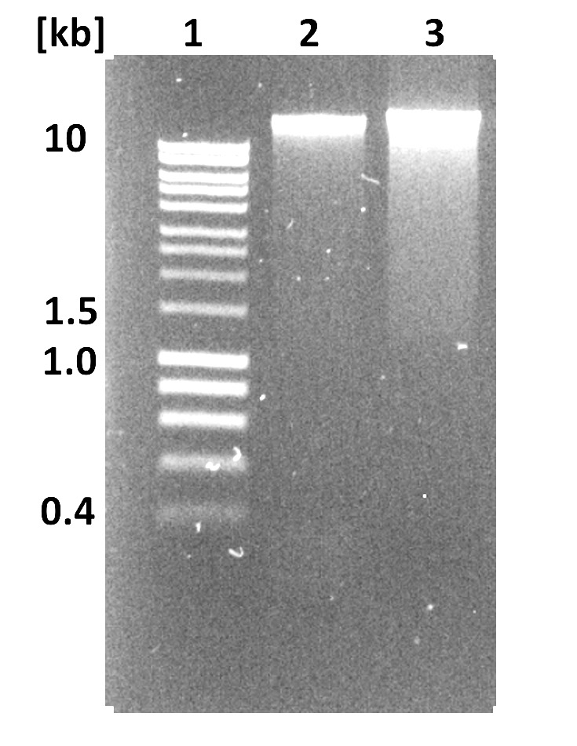
Shearing leads to short reads
Sample | Size selection | N50_{Q7} [kb] | Mean_{Q7} [kb] | Median_{Q7} [kb] | Yield [Gb] | Yield_{Q7} [Gb]
10 | NO | 25.8 | 12.4 | 6.2 | 6.0 | 5.9
27 | NO | 26 | 13.2 | 7.5 | 7.8 | 7.4
9 | sheared during extraction | 9.2 | 4.9 | 2.5 | 3.5 | 3.5
Schalamun et al., biorxiv soon

Slide 24
Why would you use a g-Tube shearing? Not sure I would if I am after long reads.
Sample | Size selection | N50_{Q7} [kb] | Mean_{Q7} [kb] | Median_{Q7} [kb] | Yield [Gb] | Yield_{Q7} [Gb]
10 | NO | 25.8 | 12.4 | 6.2 | 6.0 | 5.9
27 | NO | 26 | 13.2 | 7.5 | 7.8 | 7.4
4 | g-covaris | 18.4 | 11.8 | 9.5 | 4.8 | 4.7
23 | g-covaris | 17.9 | 11.2 | 8.5 | 7.2 | 7.0
Schalamun et al., biorxiv soon

Slide 25
Blue Pippen is great for long reads! But…..
Sample | Size selection | N50_{Q7} [kb] | Mean_{Q7} [kb] | Median_{Q7} [kb] | Yield [Gb] | Yield_{Q7} [Gb]
10 | NO | 25.8 | 12.4 | 6.2 | 6.0 | 5.9
27 | NO | 26 | 13.2 | 7.5 | 7.8 | 7.4
2 | Blue Pippin | 35.1 | 26.5 | 23.9 | 3.5 | 3.5
Add another step to the procedure
Not always reliable
Much DNA required
Schalamun et al., biorxiv soon

Slide 26
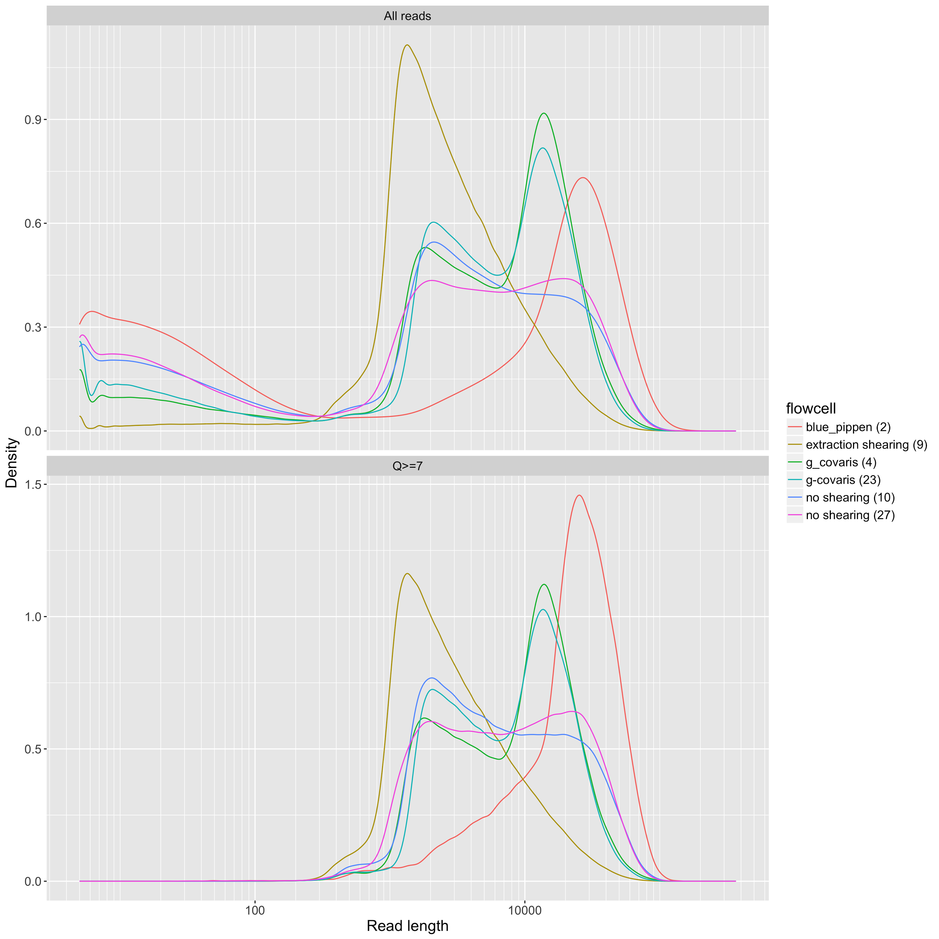
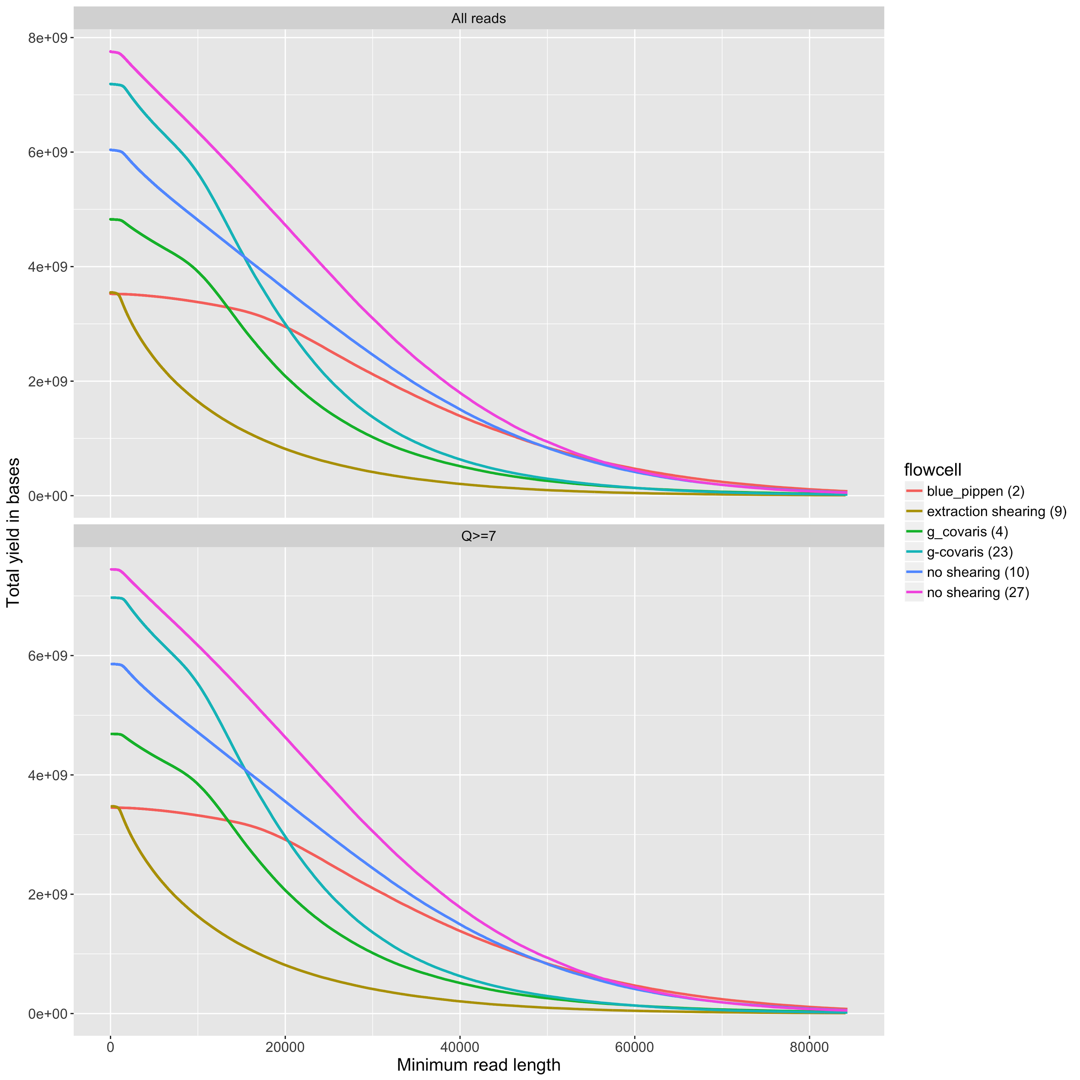
Density
Yield
Schalamun et al., biorxiv soon

Slide 27
DNA input into the adapter ligation step is must crucial for output!
at least it was for us.
Schalamun et al., biorxiv soon

Slide 28
Other tricks
Head library @ ~37oC for 10 mins at the final elution step
Use home made SPRI beads for size selection
Experience with careful run to run evaluation is most important
Check out protocols.io @
https://www.protocols.io/groups/minion-user-group-with-fungi-and-plants-on-their-mind
135 Members, 10k+ views, active discussions of protocols.
Please contribute!!!!!
Nagar
https://tinyurl.com/nanopore-tools
for a every other months updated list of nanopore tools
Schalamun et al., biorxiv soon
Nagar et al. biorxiv sometime
+ others

Slide 29
IN’s and OUT’s of DNA extraction
IN's | OUT's
Use double strand specific DNA dyes to measure concentration e.g. Qubit | Ban the vortexer!
If c[qubit] ~ c[nanodrop] the absorbance curve and the absorbance ratios at 260/280 (~1.8) and 260/230 (2.0-2.2) are good indications of DNA purity | Avoid excessive pipetting or use wide mouth pipettes
Use SPRI, e.g. AMPure, at 0.45vol for removal of smaller DNA fragments (< 1kb) | If the goal is 'whale length' reads avoid column purifications
Use 'old skool' phenol cholorform based extraction methods for high molecular weigth DNA purification a.k.a. Sambrook and Russell are your friends | You gonna hate small DNA fragments (< 1kb). Get ride of them!
Clean DNA is your friend! | Never! Never freeze DNA!
Use nuclease free water for short term storage at 4oC (couple of weeks) | Do not use EDTA in your final resupension buffer e.g. TE buffer.
Use 10mM Tris pH 8.5 for long term storage at 4oC (up to years) and for re-suspension of high molecular DNA

Slide 30
IN’s and OUT’s of library prep
IN's | OUT's
Use SPRI, e.g. AMPure, at 0.45vol for removal of smaller DNA fragments (< 1kb) | Avoid excessive pipetting or use wide pore pipettes.
Use RAPID kit with high molecular weight DNA (>200kb) for 'whale length' sequencing reads. | Ban the vortexer!
Shear high molecluar weight DNA into a specific size range for input into the 1D ligation kit. This can be done with covaris g-tubes, silica DNA clean up columns, megasdisrubter, syringe needles. | You gonna hate small DNA fragments (< 1kb). Get ride of them!
Use 1D ligation with sheared DNA (5-50kb) for highest throughut and basecalling quality. | Nanopores hate air and so will you. Avoid introducing them at all cost!
When priming the flow cell open all ports, set your pipette to a small volume when removing air initially, add appropriate priming solution and close all ports once done. | Do not leave ports and SpotON open for prolonged times (>1 mins) to avoid evaporation and introduction of air.
Have you library completely ready when performing the second priming step with the SpotON open. Load your libary immediately. | Do not always believe the official protocol. Think! E.g. Reduce the amount of ‘mixing by pipetting’ during library preparation. Mix by flicking and inversion instead.
Close all ports properly during the sequencing run. | Do not over dry SPRI beads when handling longer DNA fragments (> 10kb). About one minute airdry will be enough once all ethanol has been removed by pipetting.
Stop your sequencing run when less than 30% of your pores are in strand within one hour of starting your run. This will save our flow cell as it indicates a bad library preparation.
You can heat samples to 40-50°C for 5-10 minutes to aid elution of the SPRI beads.
One library preparation is designed for 0.2 pmoles of DNA molecules. The amount of input in ug will vary according to average fragment size e.g. 0.2 pmoles for 8kb is about 1ug.

